Slide 1

Capstone Project 2024 Coffee Business
Marivet Reynaga
Robin Anderson
Cheryl DeJournette

Slide 2
Business Question
What are the trends for the business overall and does it vary based on the product and/or the location?

Slide 3

Data Cleansing in Excel and Power BI

Slide 4
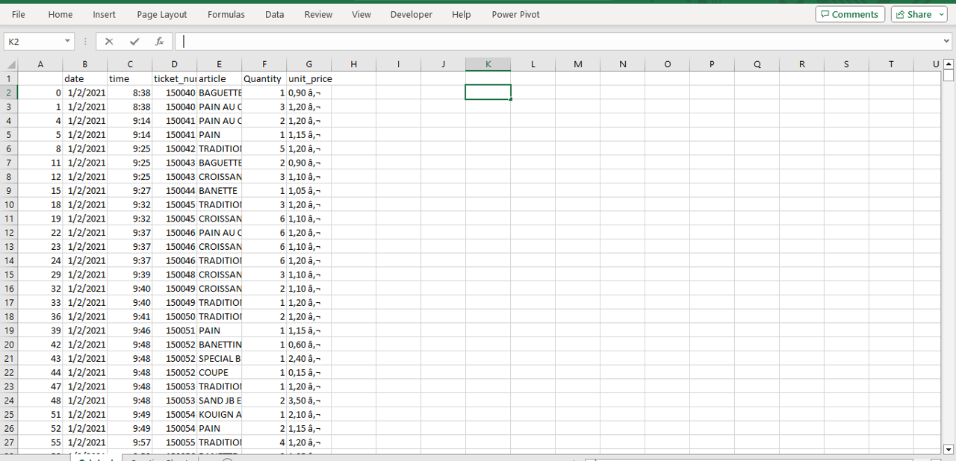
Raw data in Excel

Slide 5
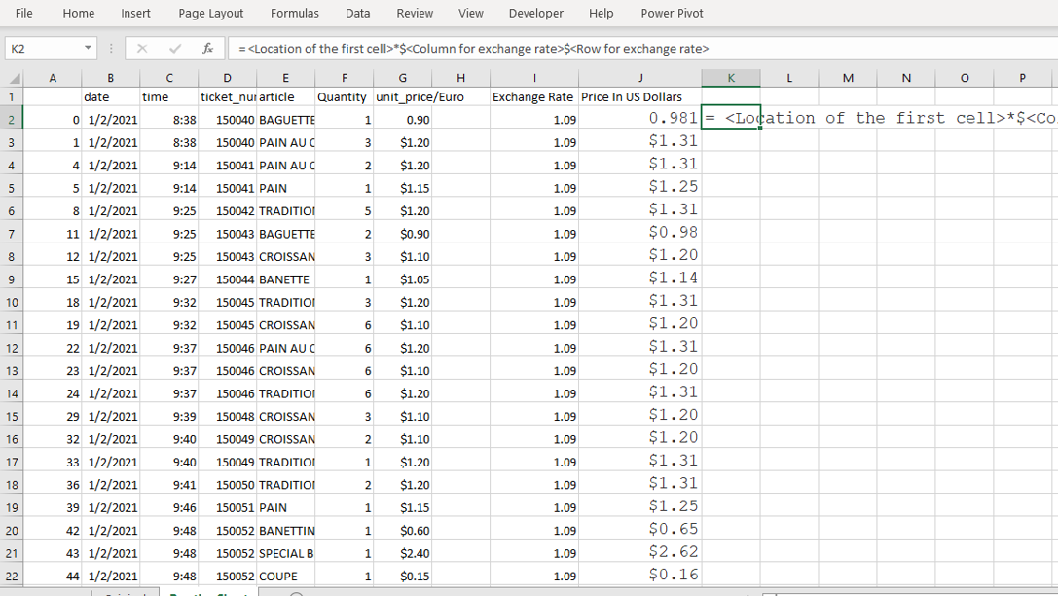
Used conversion to US Currency: G2*$I$2

Slide 6
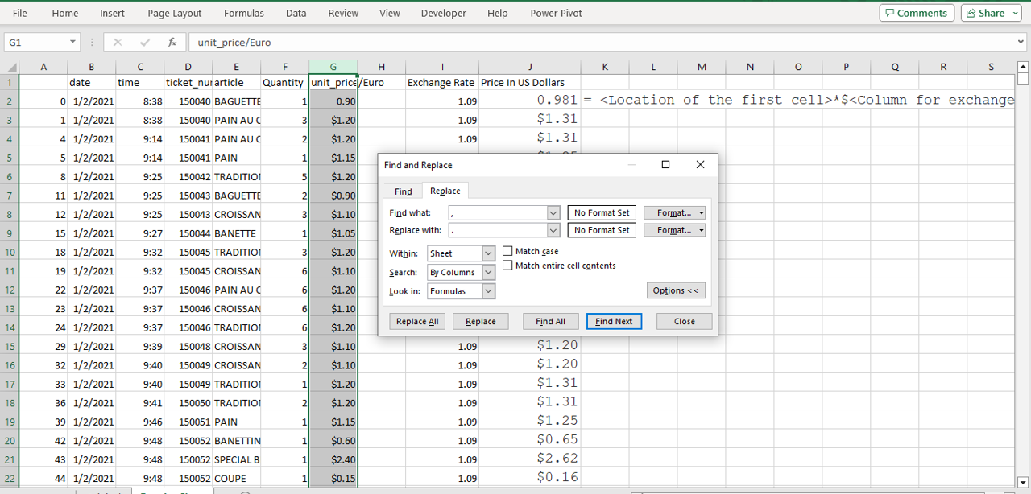
Find and Replaced; Symbols â‚¬ to $

Slide 7
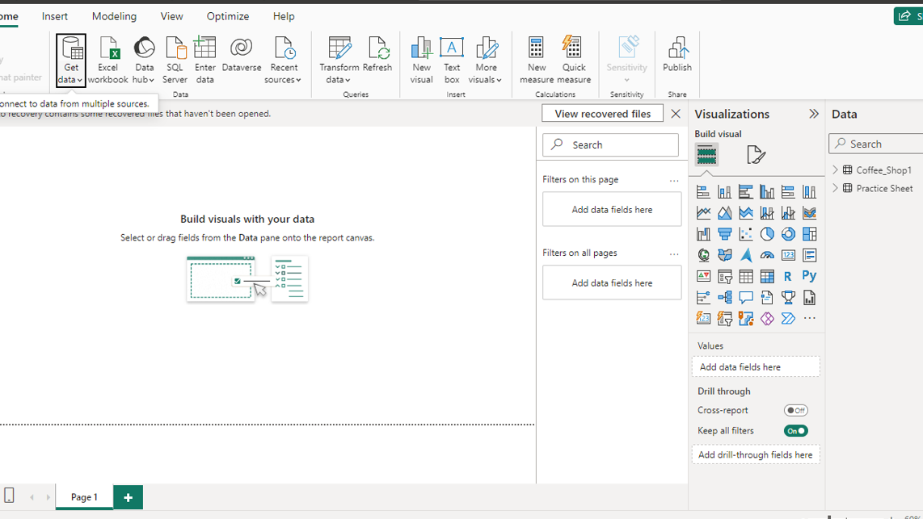
Imported Cleansed Data into Power BI-Ability to Transform at this point as well

Slide 8
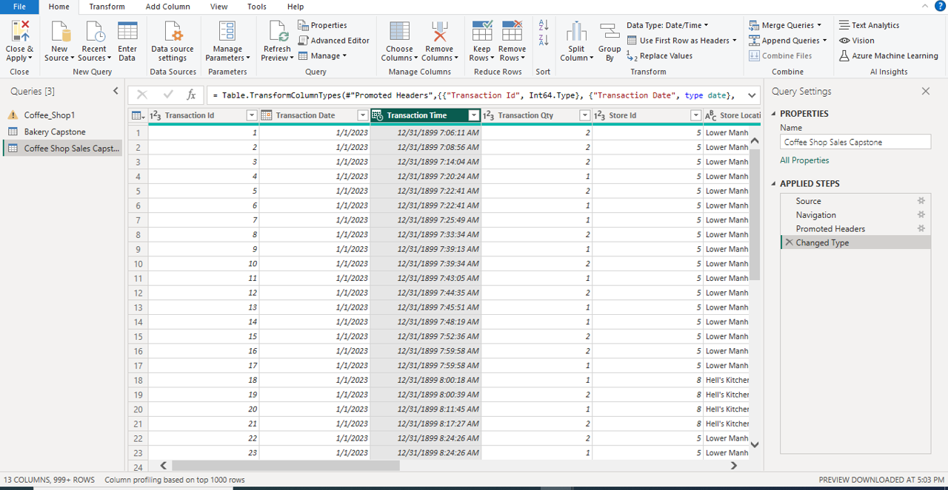
Transform Data After Importing Some More

Slide 9
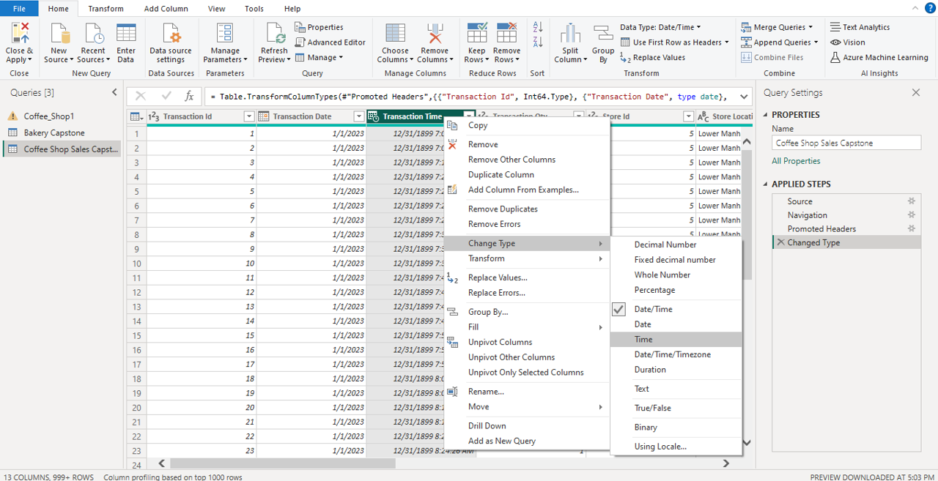
Formatted again to disclude date with time

Slide 10
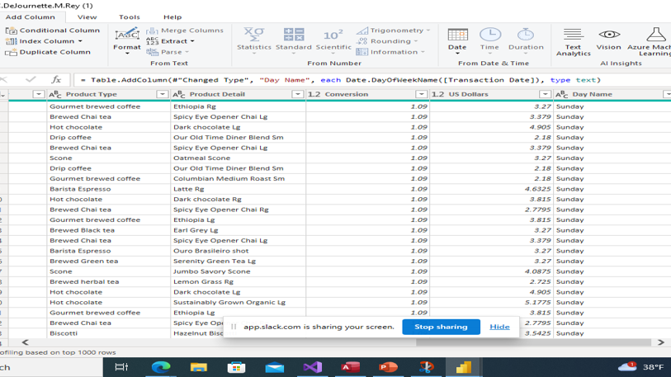
Inserted column with day name

Slide 11
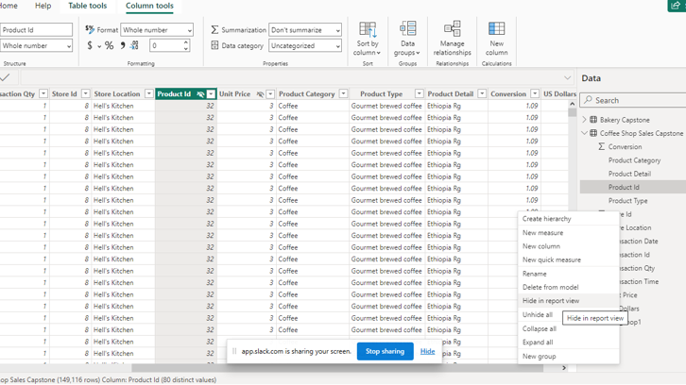
Hiding columns from report view not needed for visualizations

Slide 12
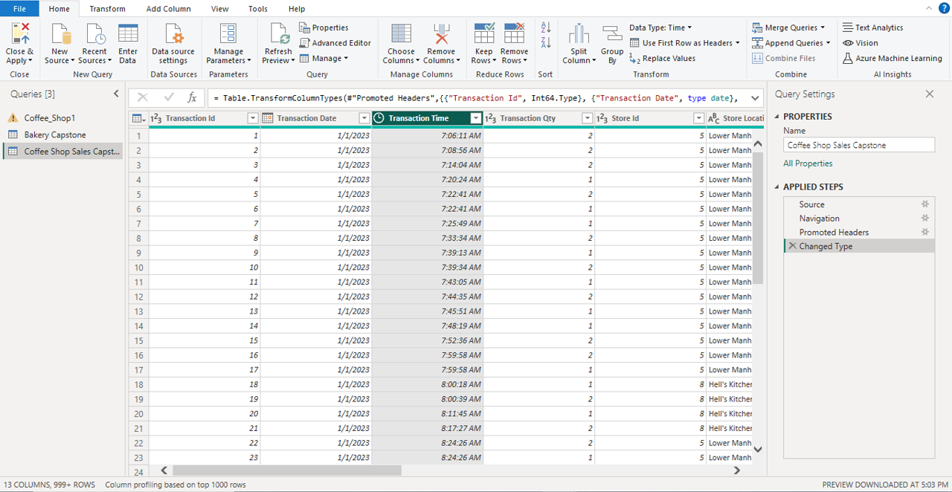
Close & Apply

Slide 13
Key Performance Indicators (KPI’s) identified using SQL

Slide 14
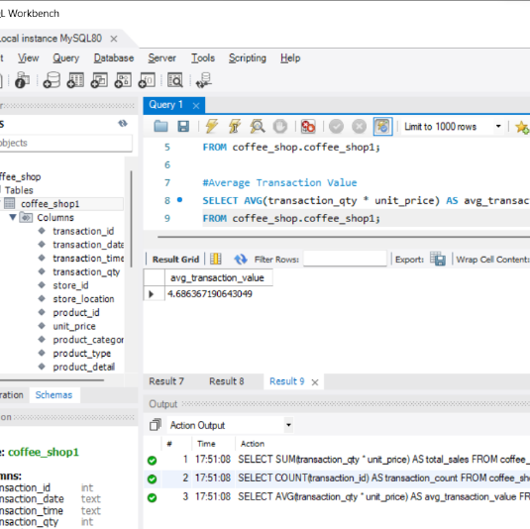
Average Transaction Value: Calculate the average amount spent per transaction.
SELECT AVG(transaction_qty * unit_price) AS avg_transaction_value
FROM coffee_shop.coffee_shop1;

Slide 15
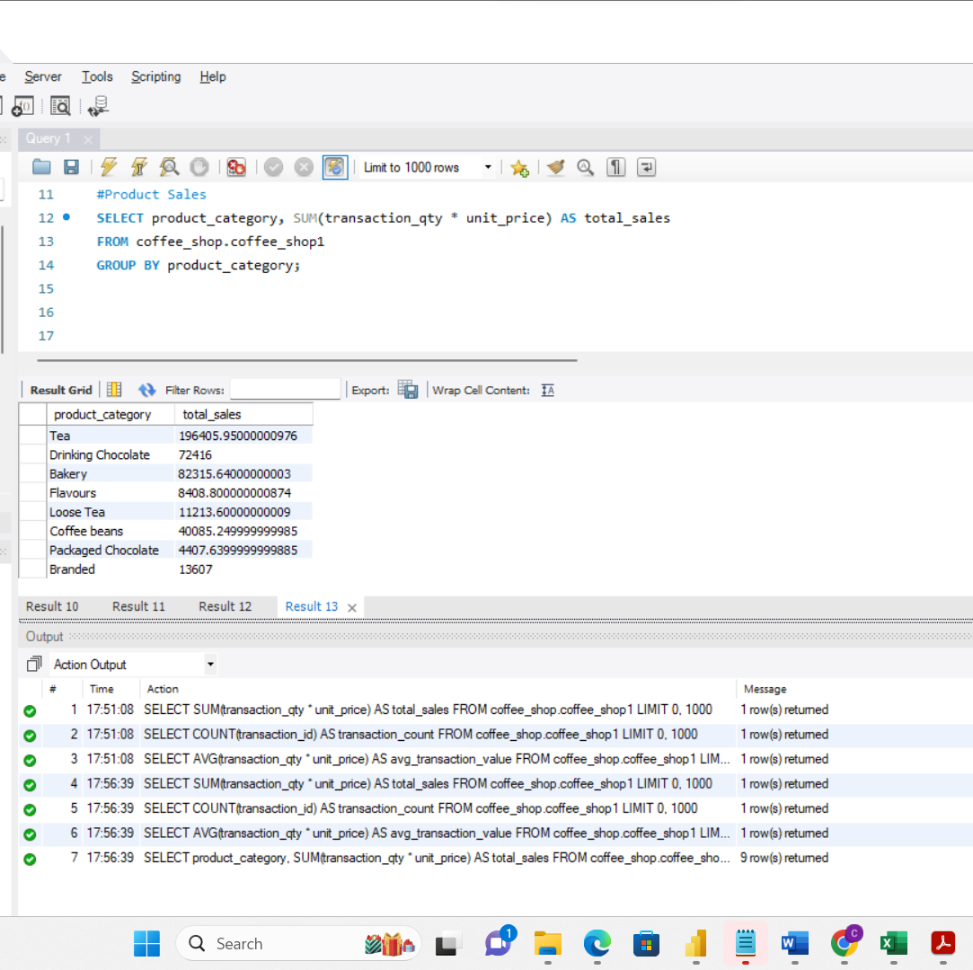
Product Sales: Break down sales by product category, type, or individual products.
SELECT product_category, SUM(transaction_qty * unit_price) AS total_sales
FROM coffee_shop.coffee_shop1
GROUP BY product_category;

Slide 16
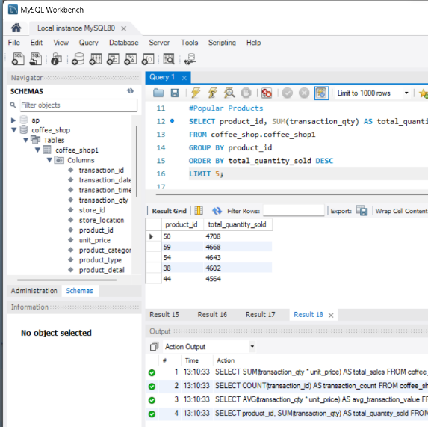
Popular Products: Determine the best-selling products or categories.
SELECT product_id, SUM(transaction_qty) AS total_quantity_sold
FROM coffee_shop.coffee_shop1
GROUP BY product_id
ORDER BY total_quantity_sold DESC
LIMIT 5;
Products:
50 Regular Earl Grey Tea
59 Large Dark Chocolate Hot Chocolate
54 Regular Morning Sunrise Chai Tea
38 Latte
44 Regular Peppermint Tea

Slide 17
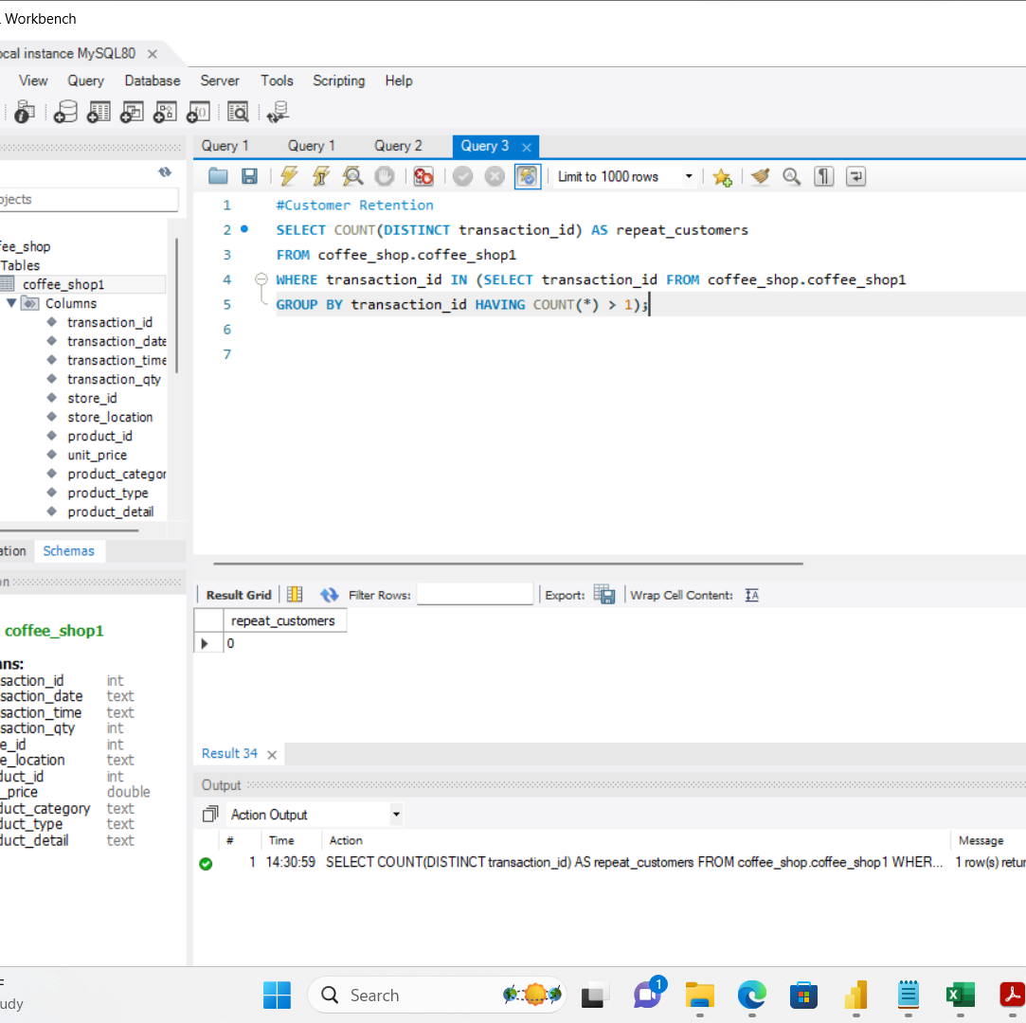
Customer Retention: Analyze repeat transactions to gauge customer loyalty.
SELECT COUNT(DISTINCT transaction_id) AS repeat_customers
FROM coffee_shop.coffee_shop1
WHERE transaction_id IN (SELECT transaction_id FROM coffee_shop.coffee_shop1
GROUP BY transaction_id HAVING COUNT(*) > 1);

Slide 18
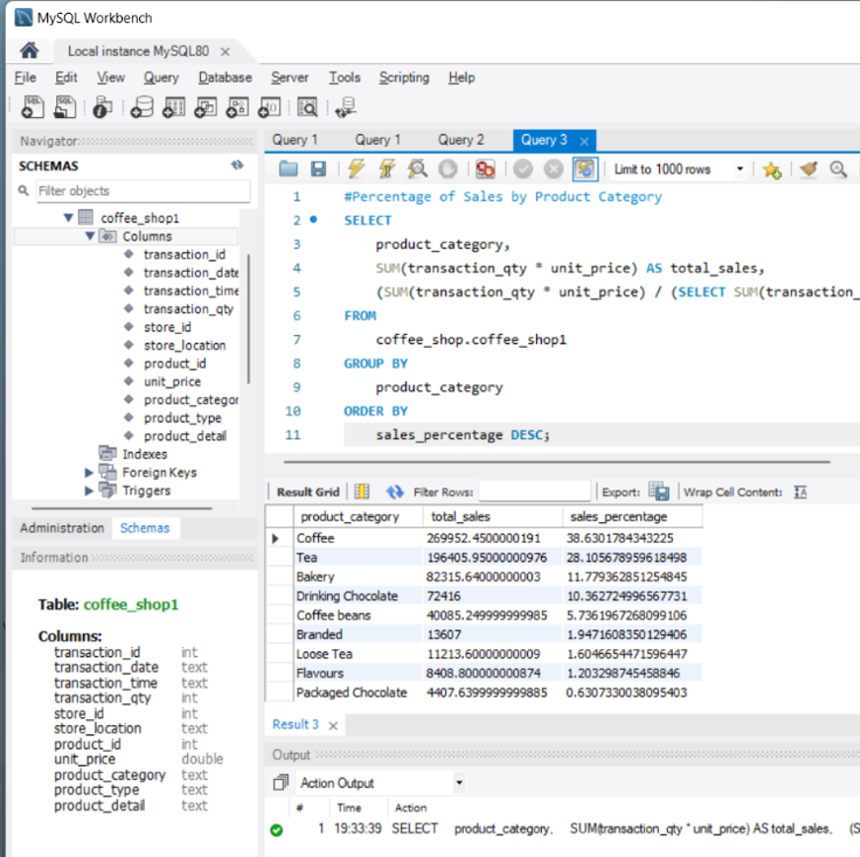
Percentage of Sales by Product Category
SELECT
product_category,
SUM(transaction_qty * unit_price) AS total_sales,
(SUM(transaction_qty * unit_price) / (SELECT SUM(transaction_qty * unit_price) FROM coffee_shop.coffee_shop1)) * 100 AS sales_percentage
FROM
coffee_shop.coffee_shop1
GROUP BY
product_category
ORDER BY
sales_percentage DESC;

Slide 19
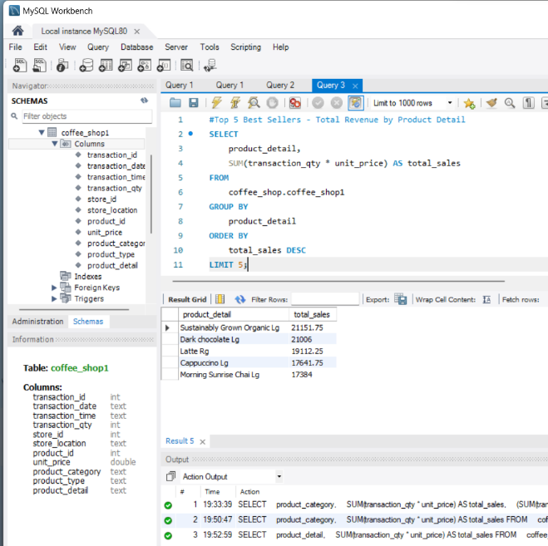
Top 5 Best Sellers – Total Revenue of Sales by Product Detail
SELECT
product_detail,
SUM(transaction_qty * unit_price) AS total_sales
FROM
coffee_shop.coffee_shop1
GROUP BY
product_detail
ORDER BY
total_sales DESC
LIMIT 5;

Slide 20
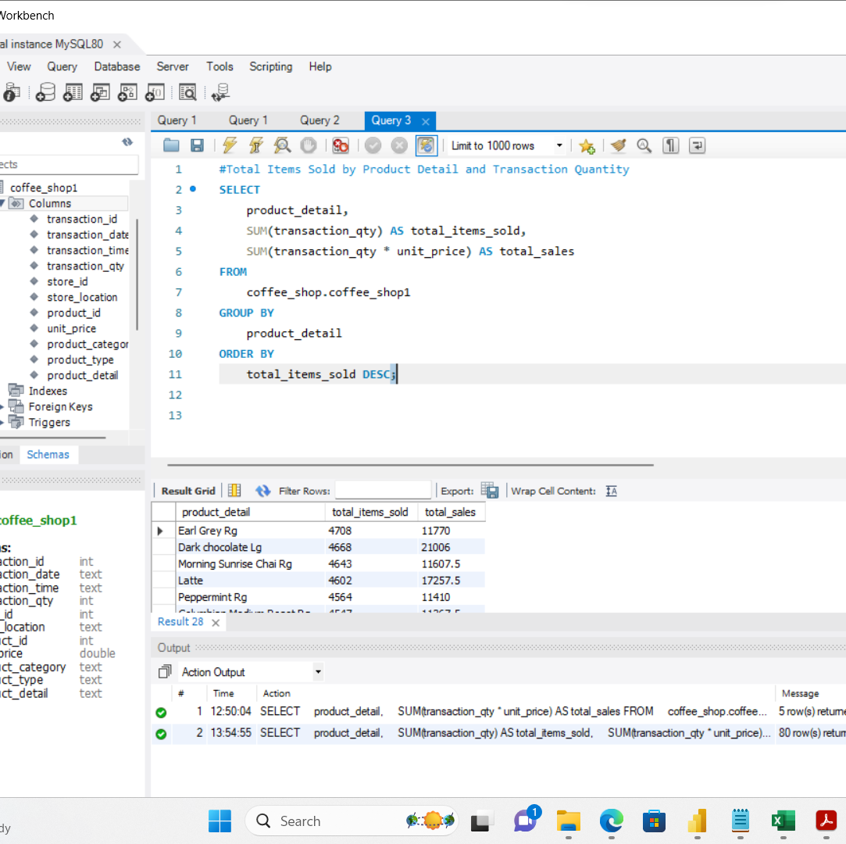
Total Items Sold by Product Detail and Transaction Quantity
SELECT
product_detail,
SUM(transaction_qty) AS total_items_sold,
SUM(transaction_qty * unit_price) AS total_sales
FROM
coffee_shop.coffee_shop1
GROUP BY
product_detail
ORDER BY
total_items_sold DESC;

Slide 21
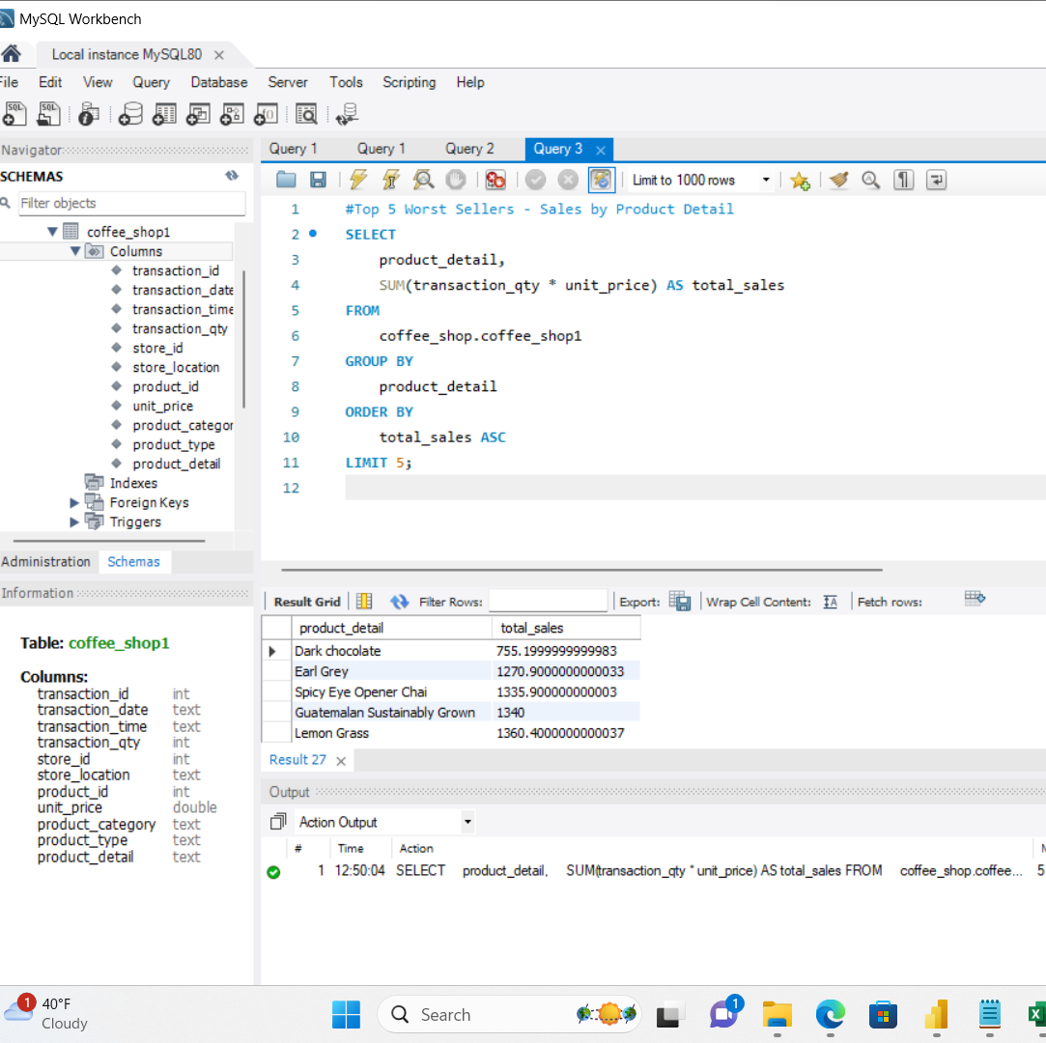
Top 5 Worst Sellers – Sales by Product Detail
SELECT
product_detail,
SUM(transaction_qty * unit_price) AS total_sales
FROM
coffee_shop.coffee_shop1
GROUP BY
product_detail
ORDER BY
total_sales ASC
LIMIT 5;

Slide 22
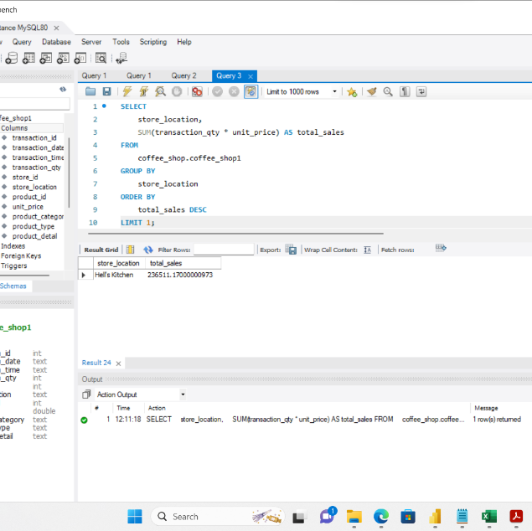
Best Selling Store Location
SELECT
store_location,
SUM(transaction_qty * unit_price) AS total_sales
FROM
coffee_shop.coffee_shop1
GROUP BY
store_location
ORDER BY
total_sales DESC
LIMIT 1;

Slide 23
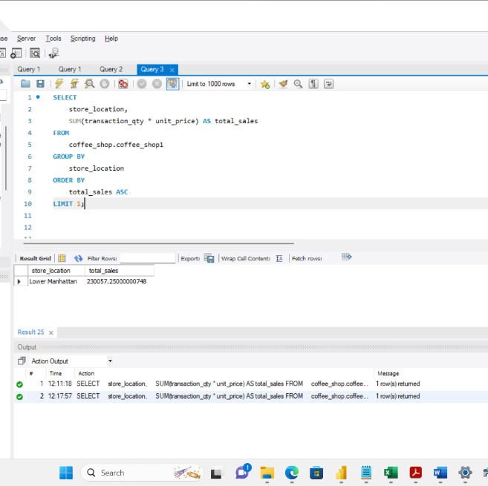
Worst Selling Location
SELECT
store_location,
SUM(transaction_qty * unit_price) AS total_sales
FROM
coffee_shop.coffee_shop1
GROUP BY
store_location
ORDER BY
total_sales ASC
LIMIT 1;

Slide 24
Power BI Visualizations

Slide 25

Conclusion
Business Question: What are the trends for the business overall and does it vary based on the product and/or the location?
Peak times
What time of day is the most profitable
Profits based on a variety of times per location
What day of the week is profitable
Most and least popular items
Most and least profitable Locations
Needing more data:
To understand the trends over a longer period of time and better capture profit
Customer Retention: Analyze repeat transactions to obtain customer loyalty
Inventory Turnover: Assess how quickly products are sold to manage stock efficiently

Slide 26

Thank you!

